Slide 1

G2M Case Study
Virtual Internship
12-May-2021

Slide 2
Background
XYZ, a privately-owned company based in the United States, is considering investing in the Cab Industry due to its significant growth in recent years and the presence of multiple major players in the market. In line with their Go-to-Market (G2M) strategy, XYZ intends to thoroughly assess the market before making a final decision. This evaluation aligns with their business objective
Objective : Furnish them with actionable insights and offer practical, valuable recommendations, to facilitate XYZ firm in their decision-making process regarding investment in the cab industry
The analysis has been divided into four parts:
Data Understanding
Cab Usage Analysis
Customer Analysis
Recommendations for investment

Slide 3
Data Exploration
24 Features( including 9 derived features)
Timeframe of the data: 2016-01-31 to 2018-12-31
Total data points :355,032
Assumptions:
Outliers are present in Price_Charged feature but due to
unavailability of trip duration details ,we are not treating this as outlier.
Profit of rides are calculated keeping other factors constant and only
Price_Charged and Cost_of_Trip features used to calculate profit.
Users feature of city dataset is treated as number of cab users in the city.
we have assumed that this can be other cab users as well(including Yellow and
Pink cab)
Cab_Data.csv
Customer_ID.csv
Transaction_ID.csv
City.csv
USholiday.csv
Final cab data

Slide 4
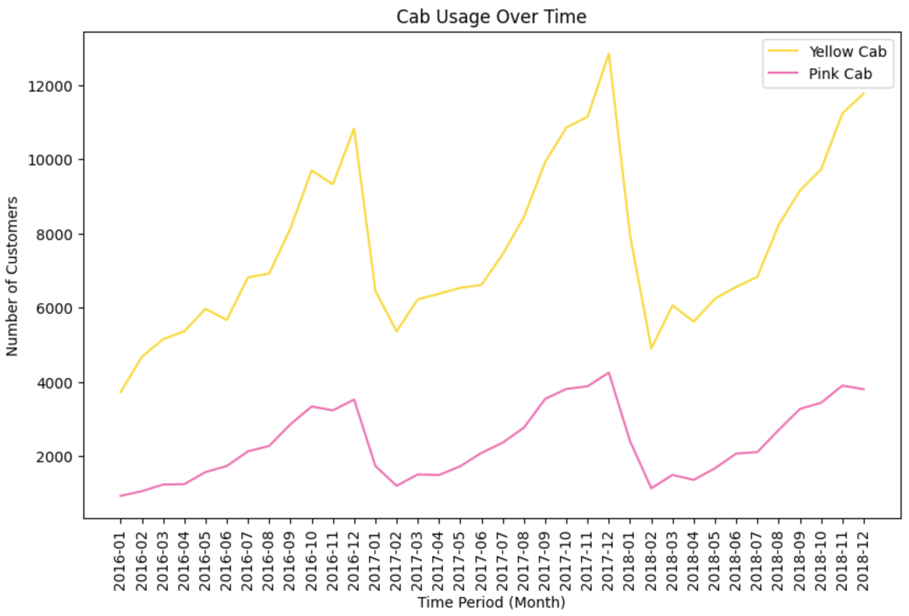
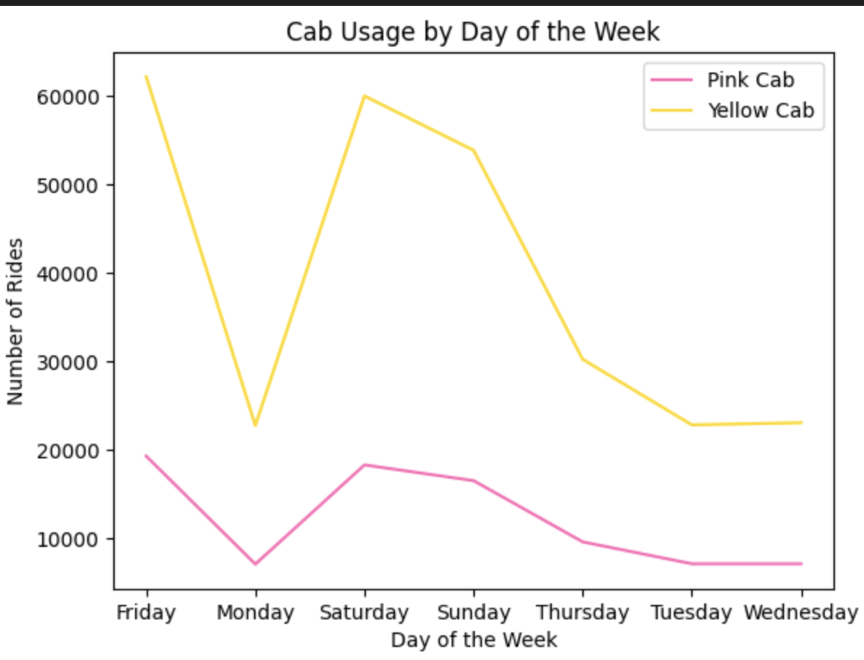
Profit Analysis
Cab Usage Analysis
The usage of cabs appears to follow a cyclical pattern over the course of three years, with the highest increase occurring between September and December, followed by a significant decline in January. However the Yellow cab is mostly used among both companies
Even on a daily basis the yellow cab remains mostly used.

Slide 5
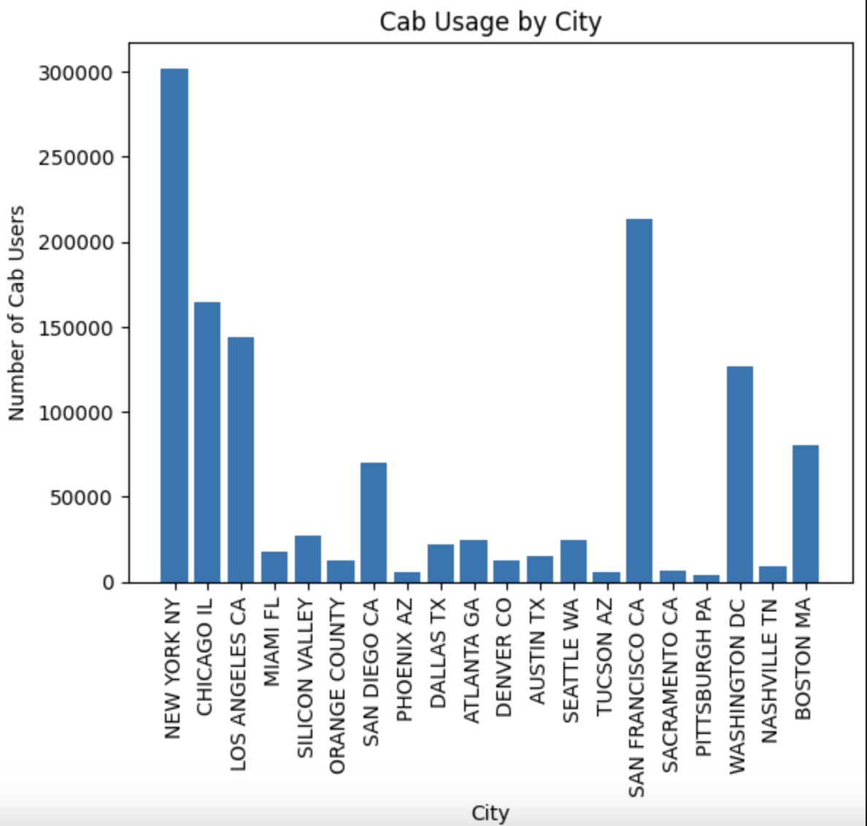
Profit Analysis
Cab Usage Analysis
The two cities with the highest cab user concentration are New York and San Francisco

Slide 6
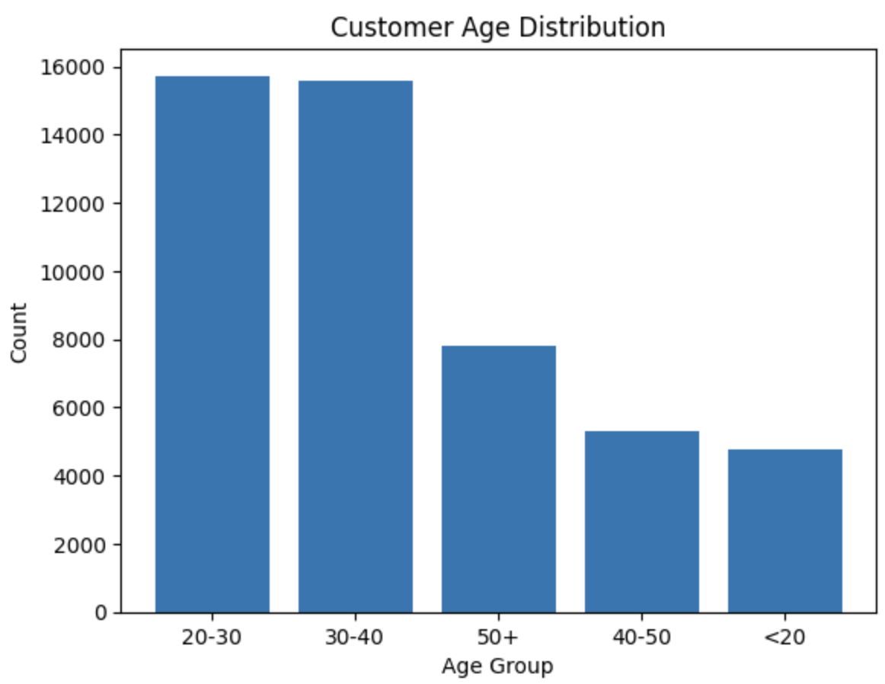
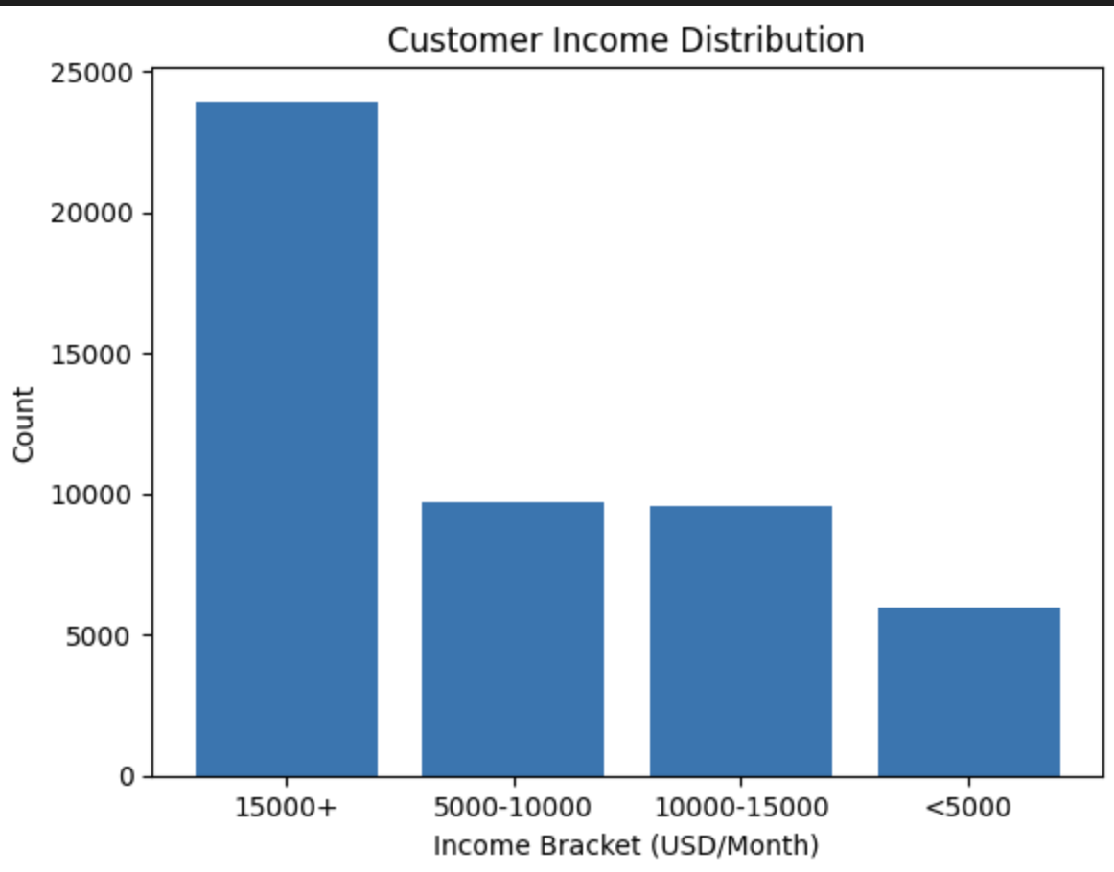
Profit Analysis
Customer Analysis
The two age groups that demonstrate the highest cab usage in v1 are individuals aged between 20-30 and 30-40 years old.
Additionally, the majority of customers fall within the highest income bracket.

Slide 7
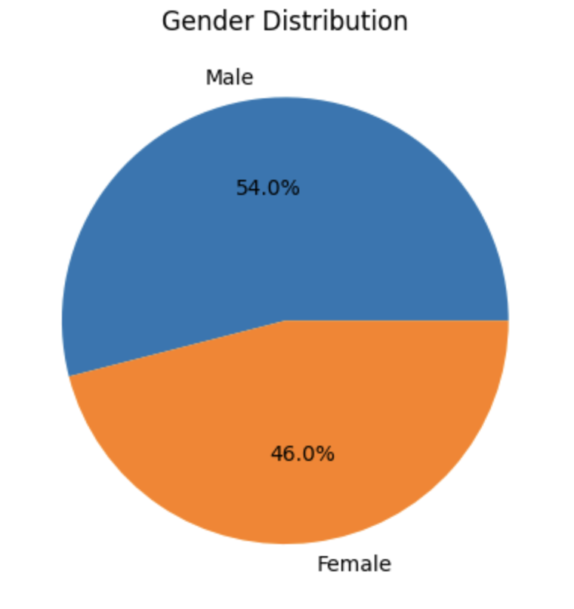
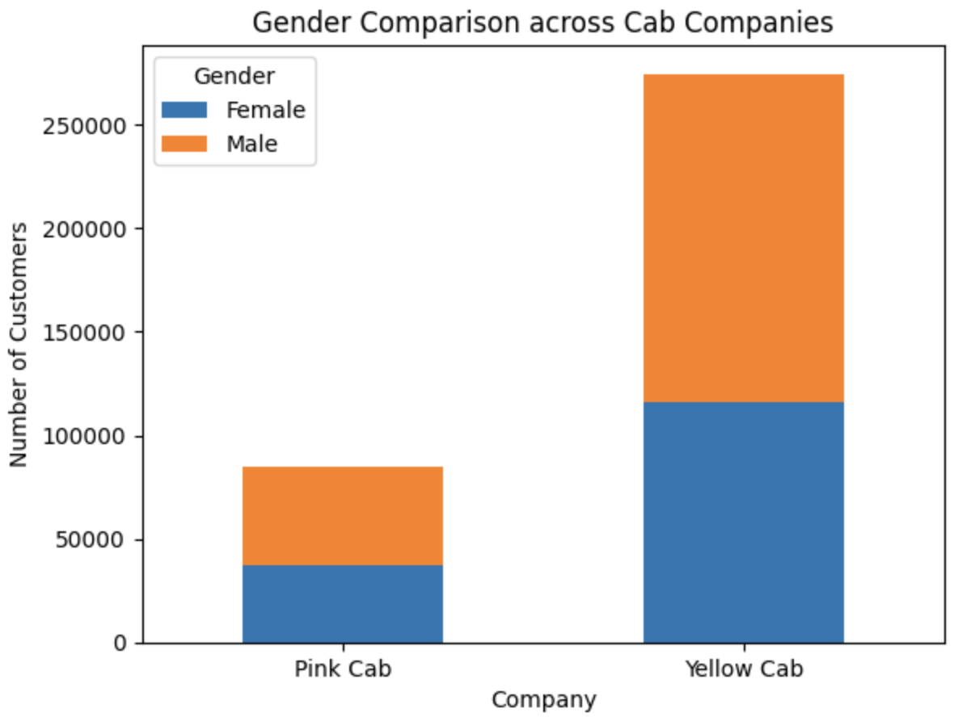
Profit Analysis
Customer Analysis
Men represent the predominant gender among cab users.
In both companies men are predominant gender among cab users.

Slide 8
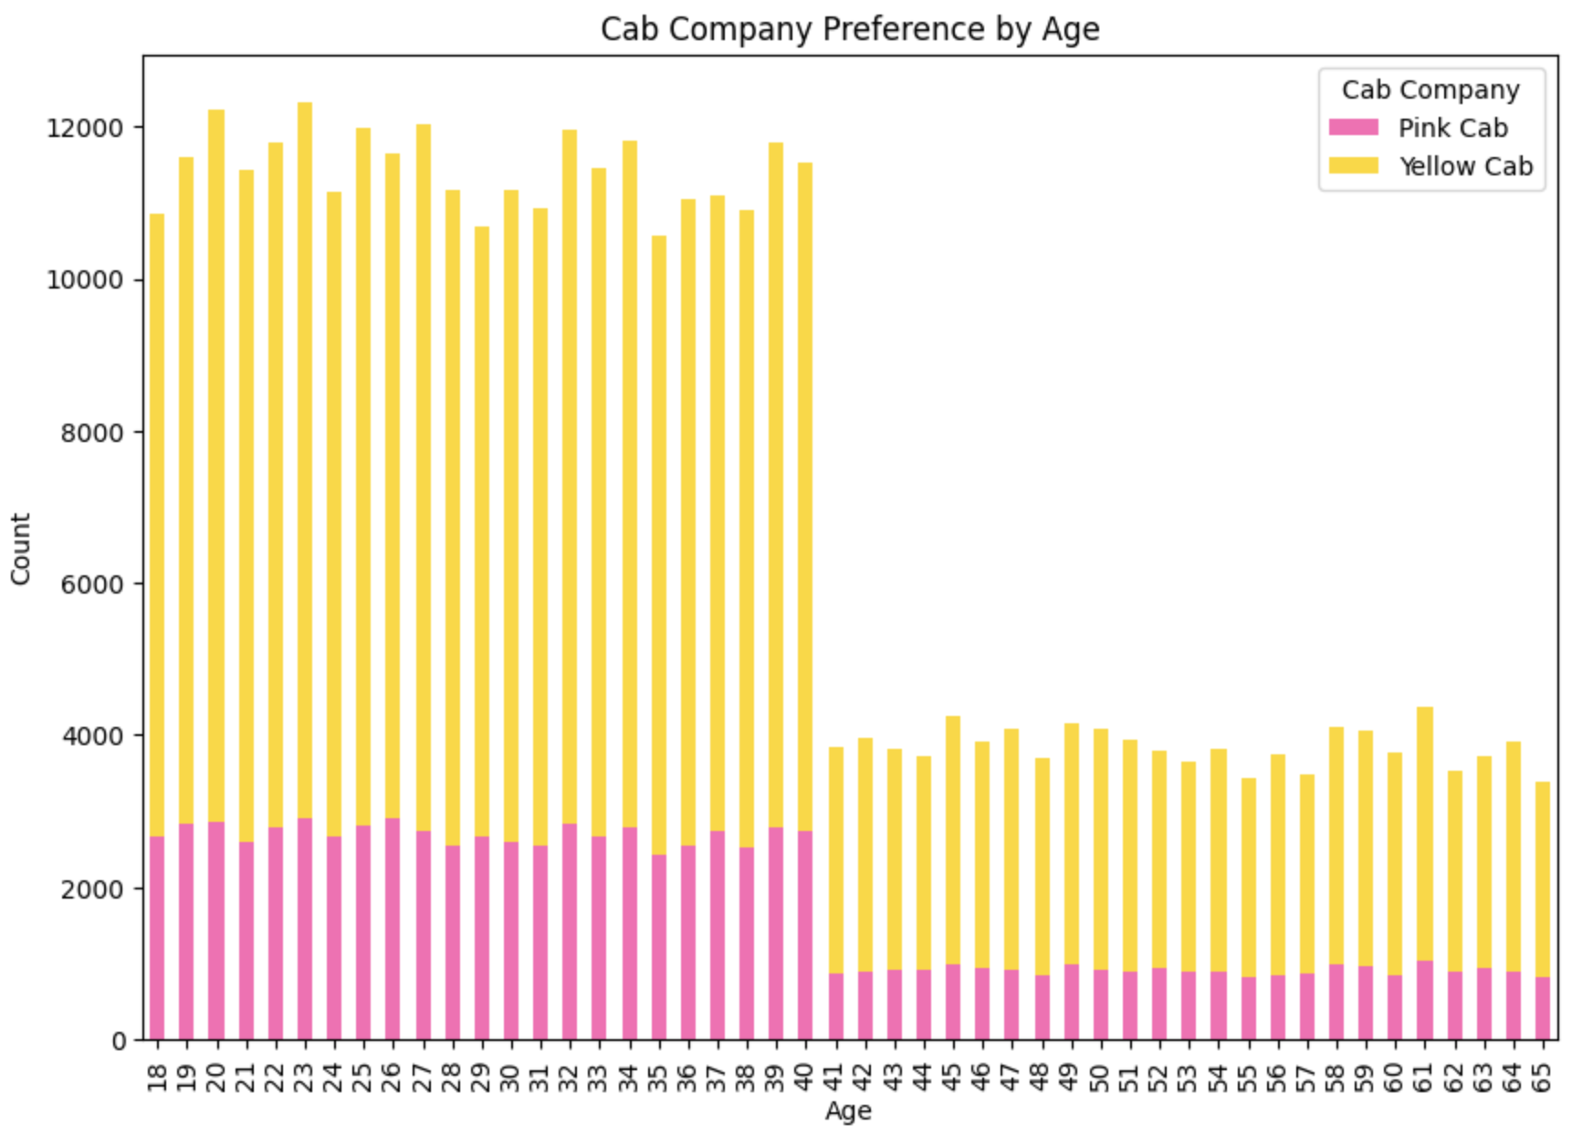
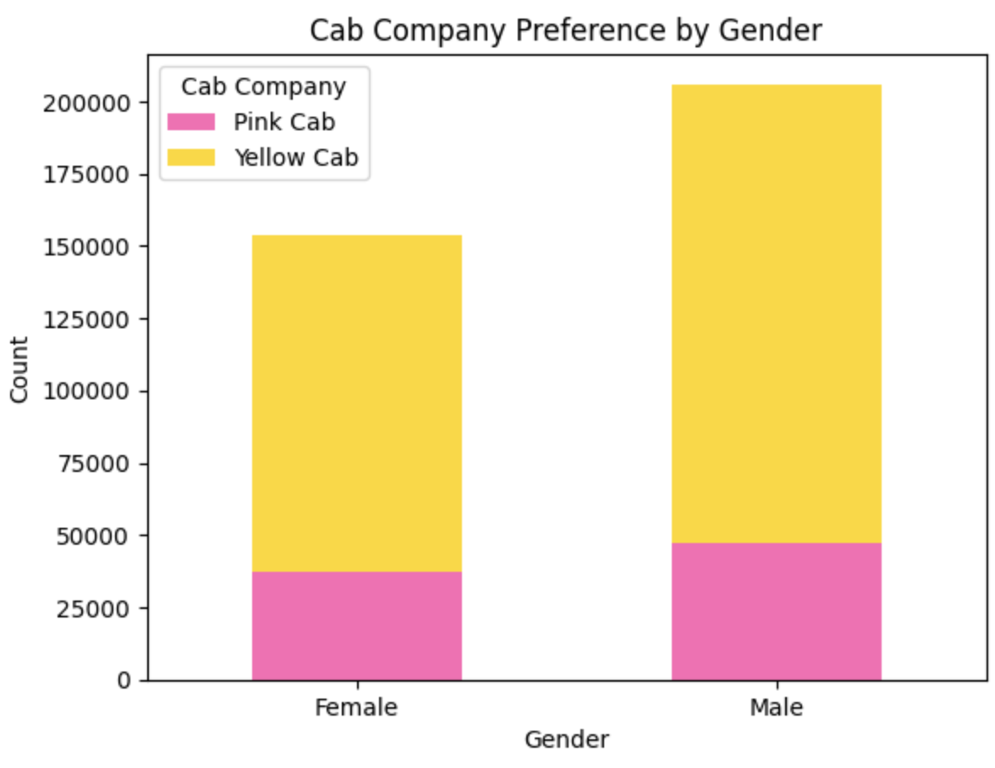
Profit Analysis
Customer Analysis
Customers of all age groups and of both genders prefer the Yellow cab.

Slide 9
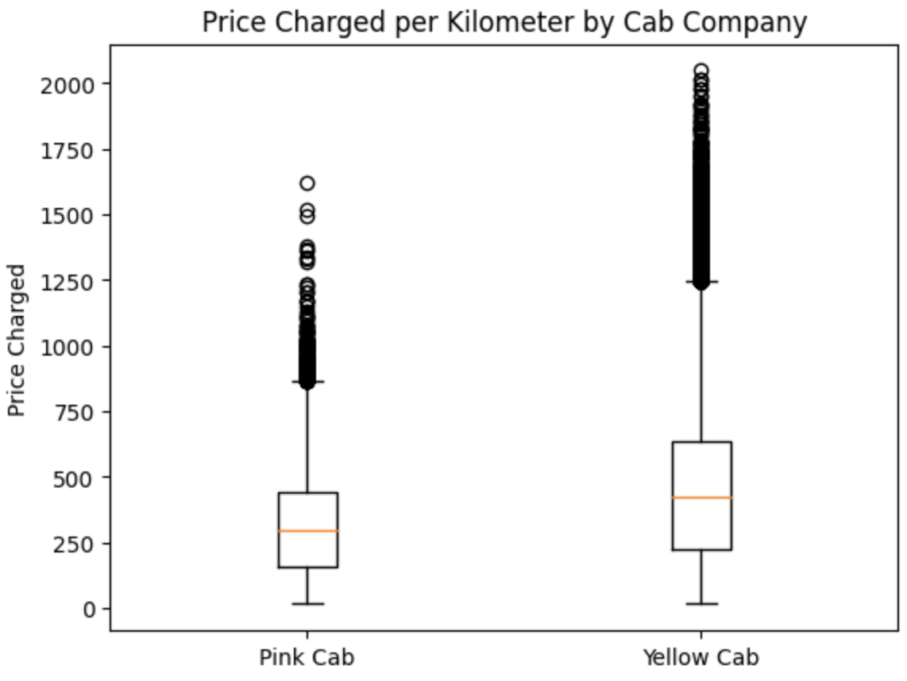
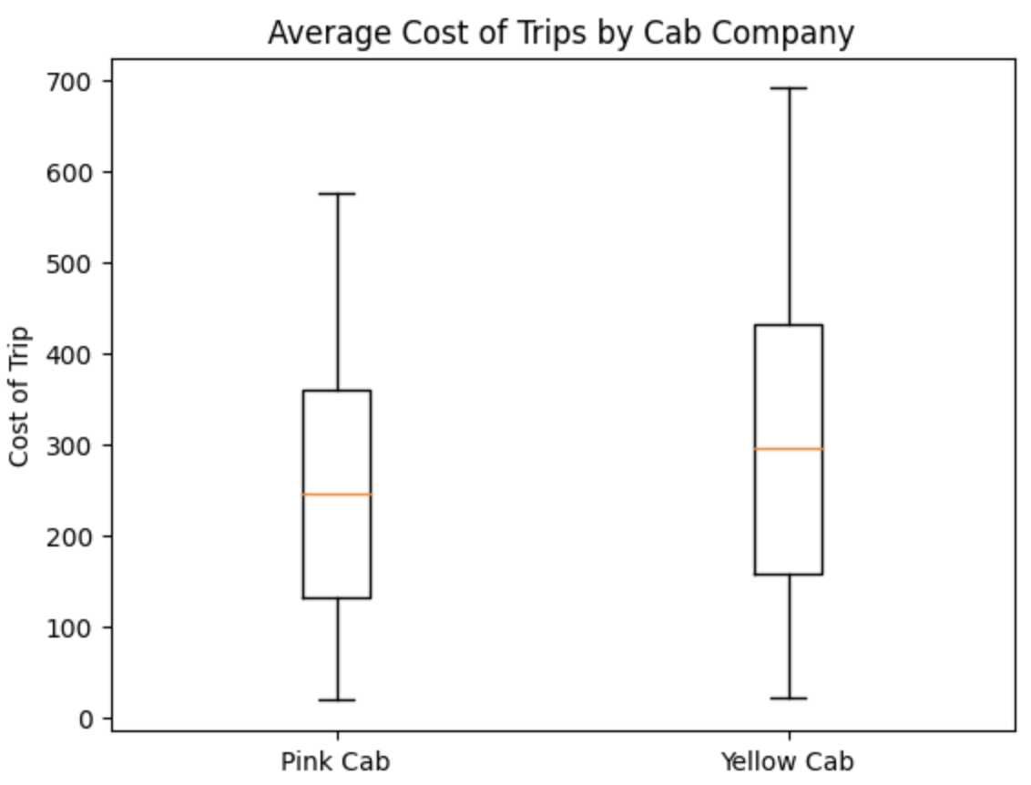
Profit Analysis
Price Comparison
The Yellow cab changes a higher price per kilometer and incurred a higher cost per trip as well.
Even Though, the Yellow cab charges customer more, most cab customer still choose the Yellow cab.

Slide 10
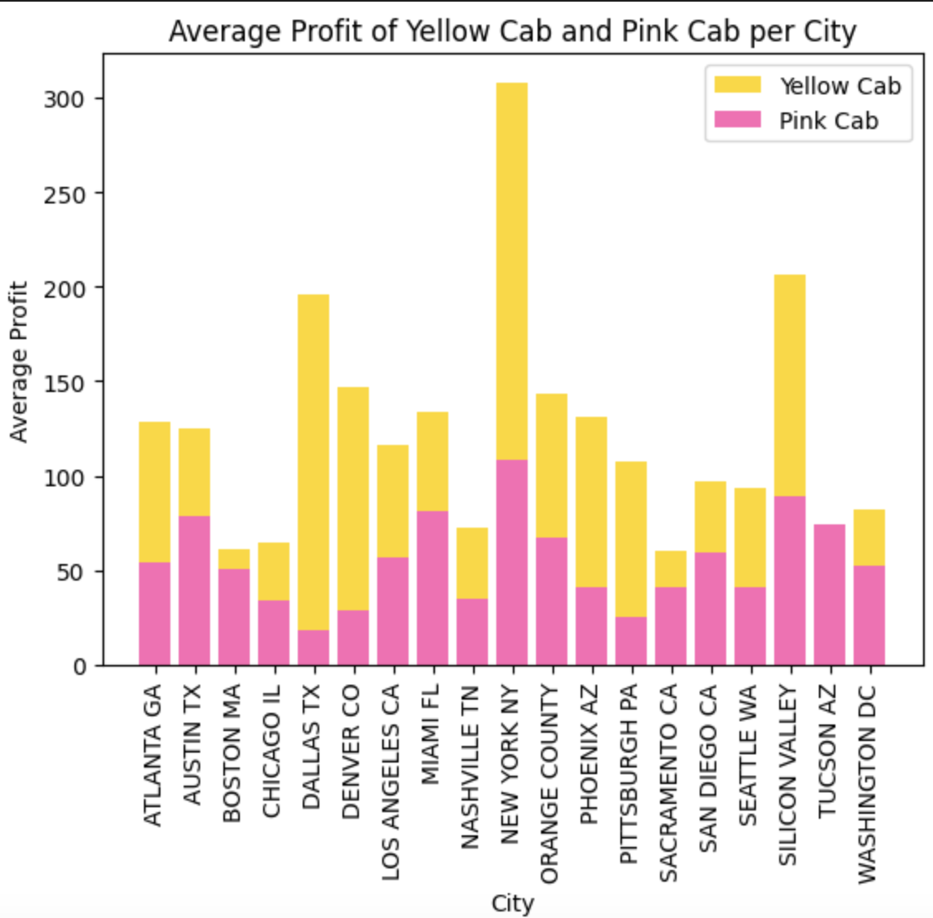
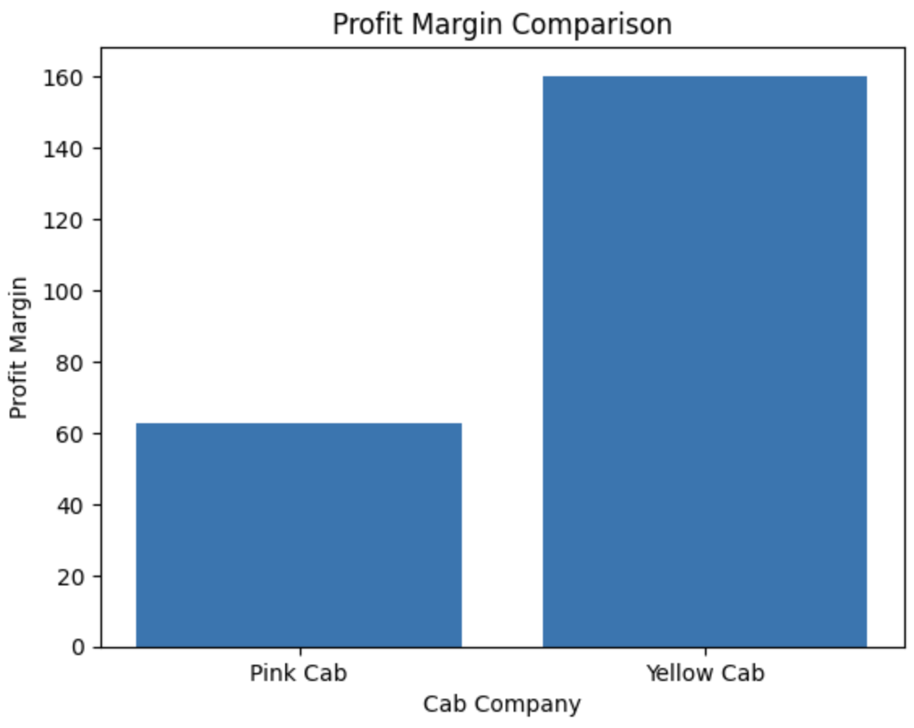
Profit Analysis
Among cab companies, New York continues to be the city generating the highest profit, closely followed by Silicon Valley. However, it is evident that the Yellow cab company holds the largest market share compared to other companies in both regions.

Slide 11
Recommendations
We have evaluated both the cab companies on following points and found Yellow cab better than Pink cab:
Market Dominance: The Yellow cab company holds the largest market share in both New York and Silicon Valley. This suggests a strong foothold in these profitable markets.
Profitability: New York and Silicon Valley are identified as the cities generating the highest profits, with New York leading the way. Acquiring the Yellow cab company would provide an opportunity to capitalize on its successful revenue generation in these lucrative regions.
Customer Demographics: Men represent the predominant gender among cab users in both cities, indicating a potential target market that aligns with the Yellow cab company's existing customer base.
Income Distribution: The majority of customers fall within the highest income bracket. This implies that the Yellow cab company may have an advantage in attracting higher-paying customers and potentially generating higher fares.
Considering these factors, acquiring the Yellow cab company would likely provide an opportunity to leverage its market dominance, profitability, and alignment with the predominant customer demographics in order to further expand and capitalize on the cab industry's potential in these regions.

Slide 12
Thank You

